Slide 1


Day 21
Math24 (Differential Equations)
Ch 4.3 The Method of Undetermined Coefficients; Higher Order (Page 236-241)
Elementary Differential Equations and Boundary Value Problems, 10th edition, by William E. Boyce and Richard C. DiPrima, ©2013 by John Wiley & Sons, Inc.

Slide 2
The method of undetermined coefficients can be used to find a particular solution Y of an nth order linear, constant coefficient, nonhomogeneous ODE
provided g is of an appropriate form.
As with 2nd order equations, the method of undetermined coefficients is typically used when g is a sum or product of polynomial, exponential, and sine or cosine functions.
Section 4.4 discusses the more general variation of parameters method.

Slide 3



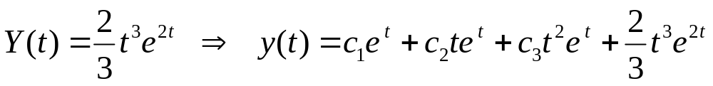
Example 1
Consider the differential equation
For the homogeneous case,
Thus the general solution of homogeneous equation is
For nonhomogeneous case, keep in mind the form of homogeneous solution. Thus begin with
As in Chapter 3, it can be shown that

Slide 4


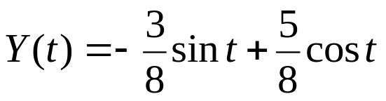

Example 2
Consider the equation
For the homogeneous case,
Thus the general solution of the homogeneous equation is
For the nonhomogeneous case, because of the form of the solution for the homogeneous equation, we need
As in Chapter 3, it can be shown that
Thus, the general solution for the nonhomgeneous equation is

Slide 5


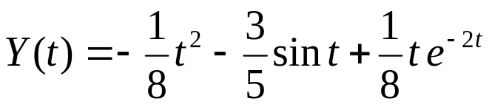
Example 3
Consider the equation
For the homogeneous case,
Thus the general solution of homogeneous equation is
For nonhomogeneous case, keep in mind form of homogeneous solution. Thus we have two subcases:
As in Chapter 3, can be shown that
The general solution is

